Slide 1



Mental Health Awareness Week
2025

Slide 2

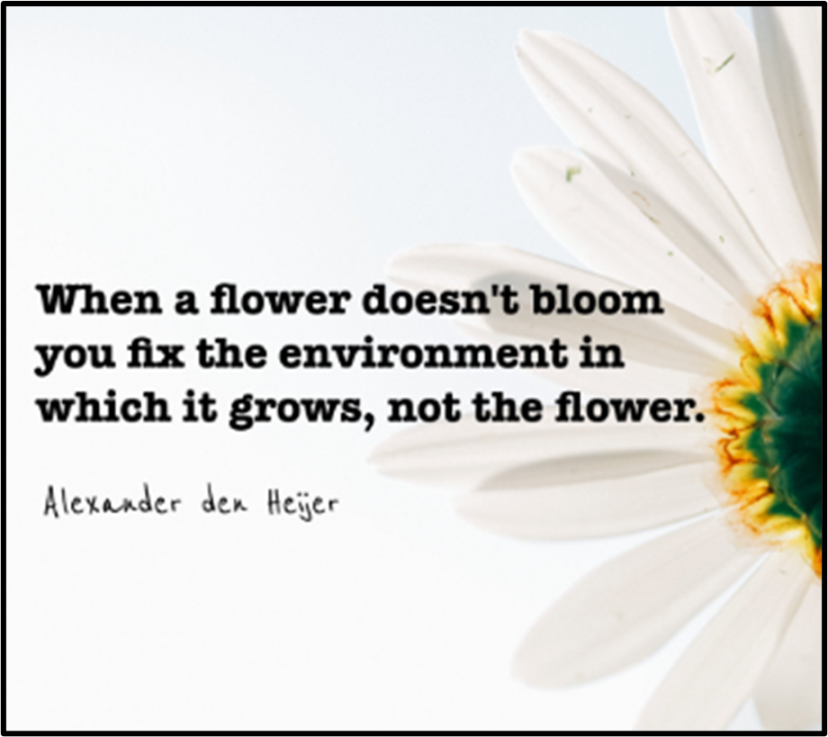
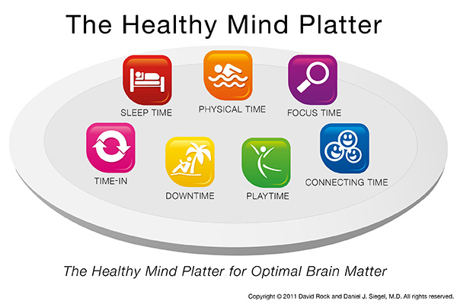

Healthy Mind Platter - Dr. Dan Siegel

Slide 3



School values are shaped by and influence moral character, underpin commitments, support relationships, and embed inclusivity within culture.
Notes:
Guide Behavior and Decision-Making:
Values provide a framework for making responsible choices and handling challenges.
Promote Academic and Social Success:
Values like perseverance and responsibility support learning and help students build positive relationships.
Prepare for Life Beyond School:
Living by strong values prepares students for citizenship, careers, and personal growth.
When school values are truly lived—they help everyone feel like they belong and that their wellbeing matters. This makes schools healthier, happier places for both learning and working.

Slide 4




Slide 5


Mental Health Continuum
Reversable distress when coping strategies, self care, relationships and lifestyle are considered.

Slide 6
Mental Health Continuum Explained
Generally satisfied,
happy in life. Emotionally well-balanced, stable and goal-oriented.
Self care strategies are
important.
Unable to cope with stress and exhibit significant changes in their thoughts, behavior, and actions.
Showing distress and struggling to complete tasks other than performing daily life functions.

Slide 7
Spotting the Signs of Wellbeing
Thoughts
Racing thoughts
‘What if’ thoughts
Difficulty concentrating
Self-critical
Low self-esteem/lack
of confidence
Spending a lot of
your day worrying
Feelings
Irritable/Frustrated
Nervous/Scared/Worried
Overwhelmed
Lonely/isolated/worthless
Impending sense of doom
Panic
Behaviour
Can’t relax or “switch off”
Trouble sleeping or tired all the time
Eating more or less than usual
Avoidance
Always looking for danger
Not socialising as much
Working with no breaks
Physical
Tense /shaky muscles
Dizzy
Breathlessness
Heart racing
Hot
Sweaty

Slide 8

Examples of Spotting the Signs of Wellbeing
Irritable/Frustrated
Nervous/Scared/Worried
Self-critical
Low self-esteem/lack of confidence
Butterflies in your stomach/Nausea
Hot
Lonely/isolated/worthless
Impending sense of doom
Racing thoughts
‘What if’ thoughts
Breathlessness
Heart racing
Relate to others
Socially active
Able to problem solve
Able to deal with some stress

Slide 9
Supporting the Signs of Wellbeing
Engaged in activities
Enjoy day to day
Looking forward to events
Well rested
Self care to be identified / increased Healthy Mind Platter
Support / coaching / therapy
Delegation of tasks
Basic needs to be priortised
Theraputic support
Self care to be supported and priortised
Medical support
Plan of support to be implemented

Slide 10
Importance of connection and belonging
Taking the time to understand how school values are lived and embed through a relational approach creates a supportive environment where every member of the school community is given the opportunity to thrive.

Slide 11

Signposting
Supporting staff wellbeing in schools booklet
3rdanna-freud-booklet-staff-wellbeing-welsh.pdf
Wellbeing measurements for school staff | Anna Freud
Guidance on Mental Health Policies for Schools & Colleges | Anna Freud
Healthy Mind Platter - Dr. Dan Siegel

