Slide 1


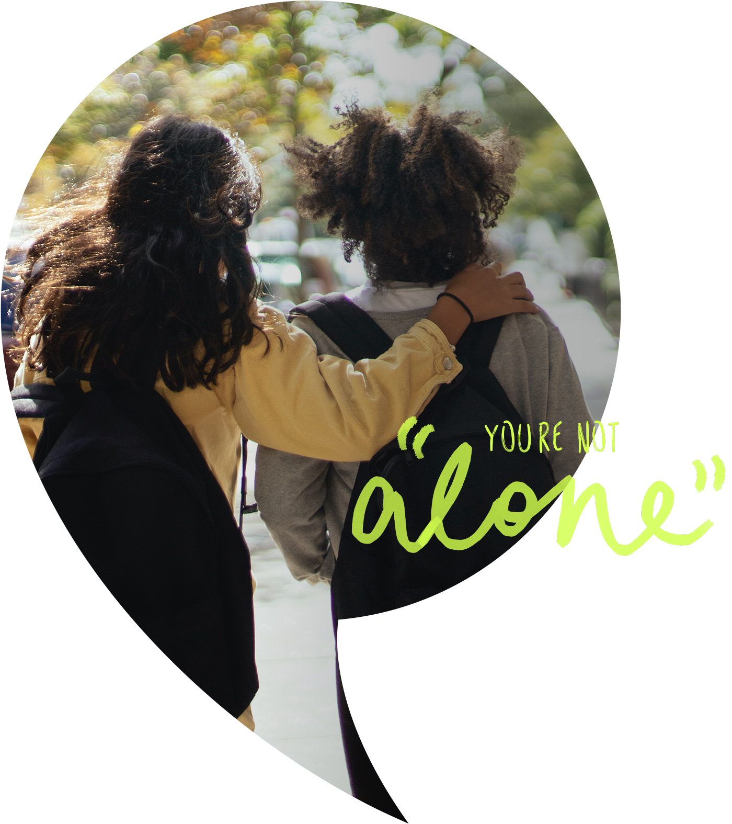
Children’s Mental Health Week 2026
Primary
‘This is My Place’
Notes:
Welcome to this year’s Children’s Mental Health week.

Slide 2

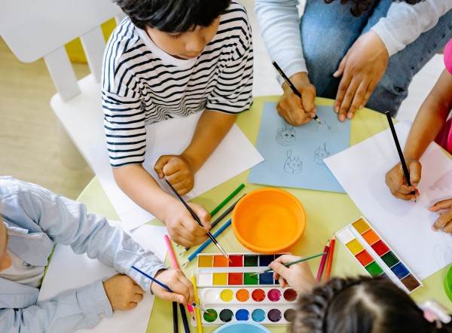
The theme of Children’s Mental Health Week is ‘This is My Place’ which is based around belonging.
Notes:
The theme of this year’s children’s mental health week is ‘This is my place’. This theme is all based around belonging.

Slide 3

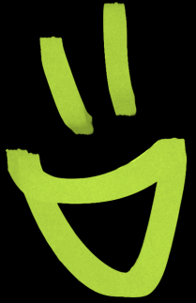
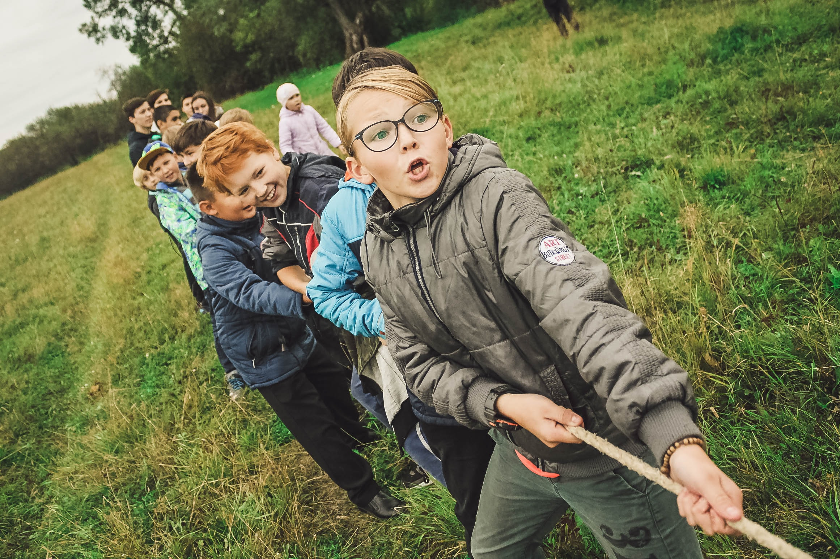
What is ‘Belonging’?
Belonging means feeling like you are accepted, included and valued for who you are. It’s when you feel safe and happy to be yourself, and you know you are part of a group- like your class, your school or your family.
Examples:
Belonging is when you have friends to play with
Belonging is when people listen to you and
care about your ideas
Belonging is when you feel proud to be part
of your school
Notes:
Belonging means feeling like you are accepted, included and valued for who you are. It’s when you feel safe and happy to be yourself, and you know you are part of a group- like your class, your school, or your family.
Examples:
- Belonging is when you have friends to play with
- Belonging is when people listen to you and care about your ideas
- Belonging is when you feel proud to be part of your school

Slide 4
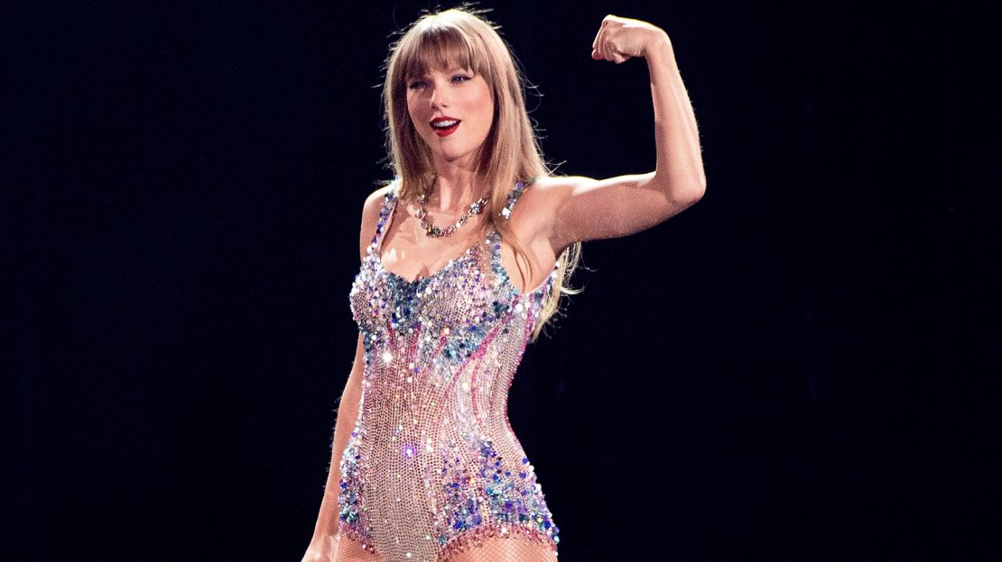
"You belong in this world just as much as anyone else. Never let anyone make you feel like you don’t.”
-Taylor Swift
Notes:
As Taylor Swift says: "You belong in this world just as much as anyone else. Never let anyone make you feel like you don’t.”
This quote means you are important and have a place in the world. You should never think that you don’t belong because everyone belongs.

Slide 5




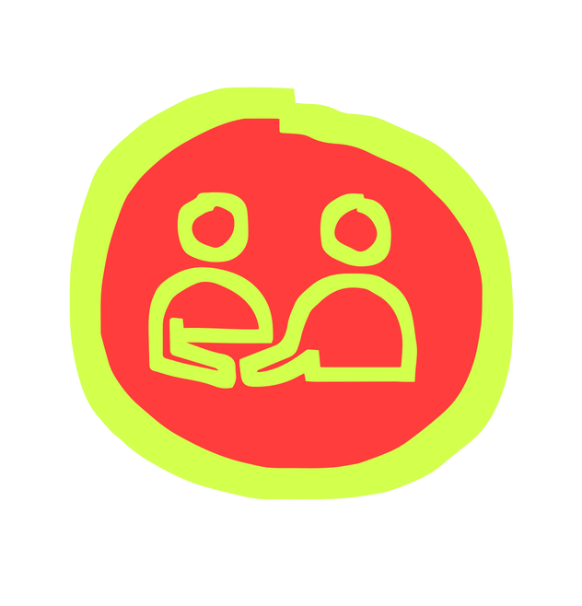

Wellbeing is
‘feeling good and functioning well’
CLANG
Notes:
Children’s mental health week is a good time to remind everyone about wellbeing. Wellbeing is feeling good and functioning well.
Knowing what makes us feel good and function well is important - and different for everyone.

Slide 6
The 5 Ways to Wellbeing
CLANG
Keep Learning
Take Notice
Connect
Be Active
Give
Notes:
The 5 ways to wellbeing can help us feel good and function well by helping us to:
Connect with others and the world around us
Keep learning new things to help us to build our self esteem and resilience. Self esteem tells us how we feel about ourselves and resilience helps us to carry on when things feel tough
Take notice of what's around us to help keep ourselves calm and comfortable, focusing on what we can see, hear and feel in our environment
Be active - we don't have to be the next Olympian to be active but we do want to move our bodies every day to help keep our mind and body working nicely together
Give - being kind and considerate is an easy way we can give back to others. When we give kindness it makes us feel good and it helps the person who we have cared for to feel good too.
An easy way to remember the 5 ways to wellbeing is CLANG.

Slide 7
CLANG
Children’s Mental Health Week is a great chance to focus on the Five Ways to Wellbeing and think about how we can link them to belonging.
Notes:
Children’s Mental Health Week is a great chance to focus on the Five Ways to Wellbeing and think about how we can link them to feeling a sense of belonging. Here are a few ideas to get you started this children's mental health week.

Slide 8
Connect
Belonging means feeling connected to others and knowing you are an important part of a community, group or team.
Turn to the person next to you and share a fact about yourself
CLANG
Notes:
Connect: Belonging means feeling connected to others and knowing you are an important part of a community, group, or team.
Let’s connect with someone now. Turn to the person next to you and share a fact about yourself. We’re going to share a fact about ourselves with you all first (pupils presenting to each share a fact about themselves)
Once you have shared, put your hand up if you would like to share your fact with the room.

Slide 9
Keep Learning
When you learn new things together, it helps you feel part of a group.
Would someone like to come to the front to teach us all how to say ‘hello’ in another language?
CLANG
Notes:
Keep Learning: When you learn new things together, it helps you feel part of a group.
Let’s see if we can learn something new together now.
Would someone like to come to the front to teach us all how to say ‘hello’ in another language?

Slide 10
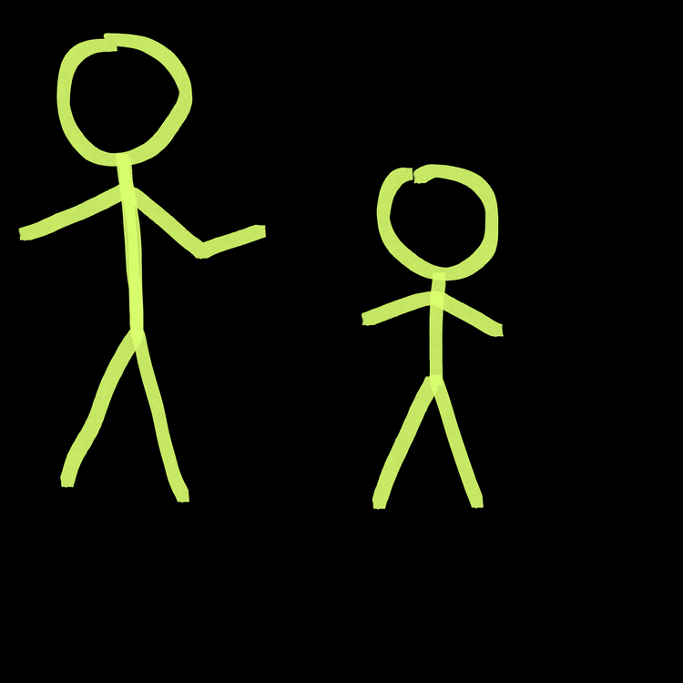
Be Active
Playing games with others helps you to feel part of a group.
Turn to the person next to you and share a game or activity you enjoy that others could easily join in.
CLANG
Notes:
Be Active: Playing games with others helps you to feel part of a group.
Turn to the person next to you and share a game or activity you enjoy that others could easily join in.
Would anyone like to share their game ideas with the room?
(If pupils presenting feel confident to, they could lead an activity with the assembly e.g. The yoga sun game or other brain break activities/games they know)

Slide 11
Take Notice
Take time to notice the things that are special to you and make you feel happy around your home and school.
Look around the room now. What makes it feel like your place (photos, work on the walls etc.)?
CLANG
Notes:
Take notice: Take time to notice the things that are special to you and make you feel happy around your home and school.
Look around the room now. What makes it feel like your place? Are there things such as photos, achievements or work on the walls?

Slide 12
Give
Acts of kindness help others feel they belong. We have been thinking about our own acts of
kindness for the week…
Turn to the person next to you and share your idea for something kind you can do this week.
CLANG
Notes:
Give: Acts of kindness help others feel they belong. Acts of kindness might include: inviting someone to join in your game, smiling at others during the day or taking the time to listen to a friend.
We have been thinking about our own acts of kindness for the week… (pupils presenting to each share an act of kindness they will be doing this week)
Turn to the person next to you and share your idea for something kind you can do this week.
If you feel confident to, you can then share it with the room.

Slide 13

Choose at least one of the 5 Ways to Wellbeing activities to do this Children’s Mental Health Week; to help yourself and others feel a sense of belonging.
CLANG
Notes:
Thank you for listening and involving yourselves today. Choose at least one of the 5 Ways to Wellbeing activities to do this Children’s Mental Health Week; to help yourself and others feel a sense of belonging.
Think about how you can then include some of these activities in the future to help both your own wellbeing and the wellbeing of others.

