Slide 1


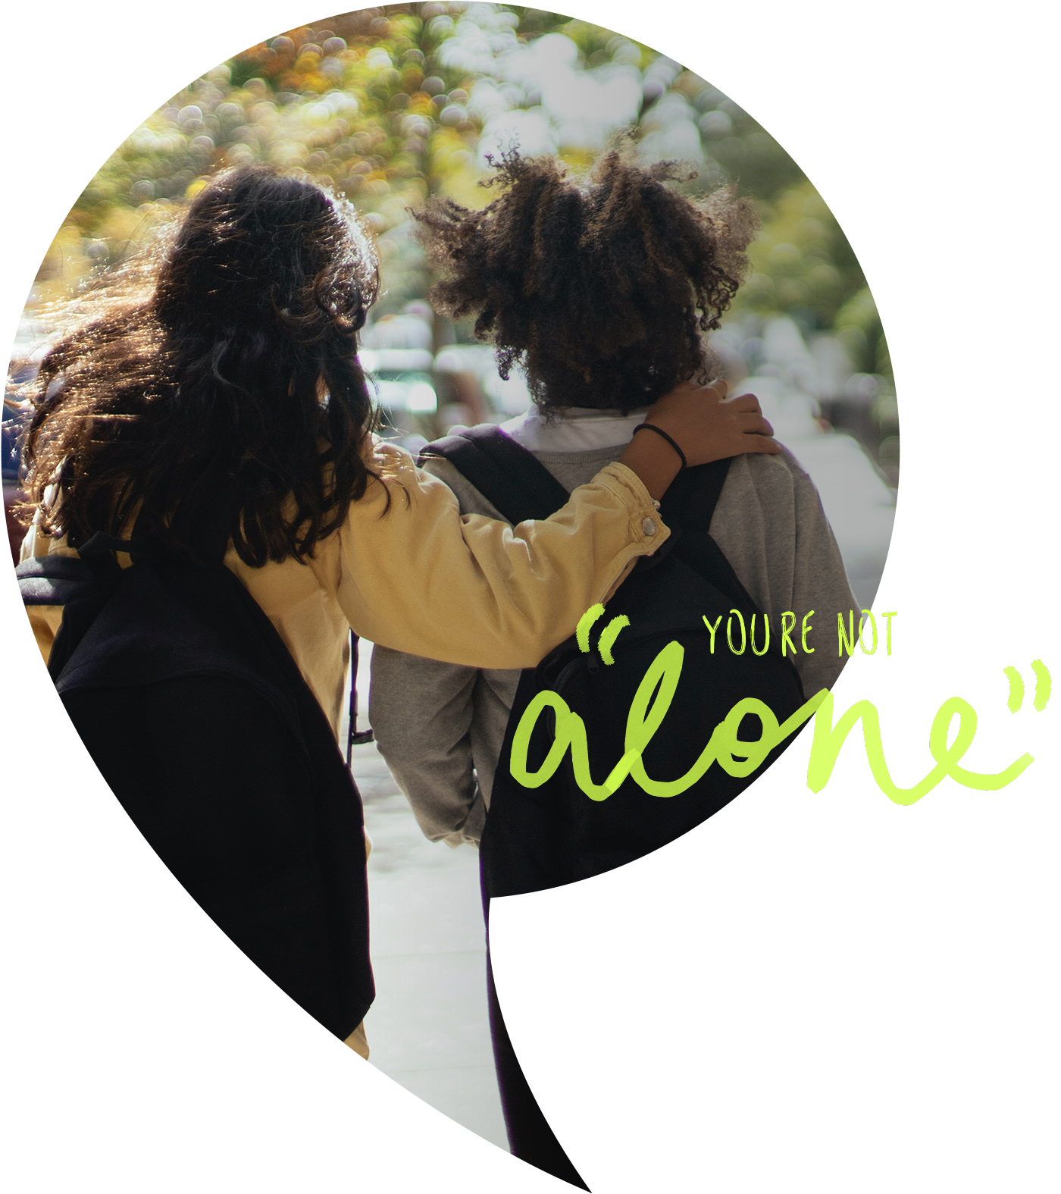
Children’s Mental Health Week 2026
Secondary
‘This is My Place’
Notes:
Welcome to this year’s Children’s Mental Health week.

Slide 2

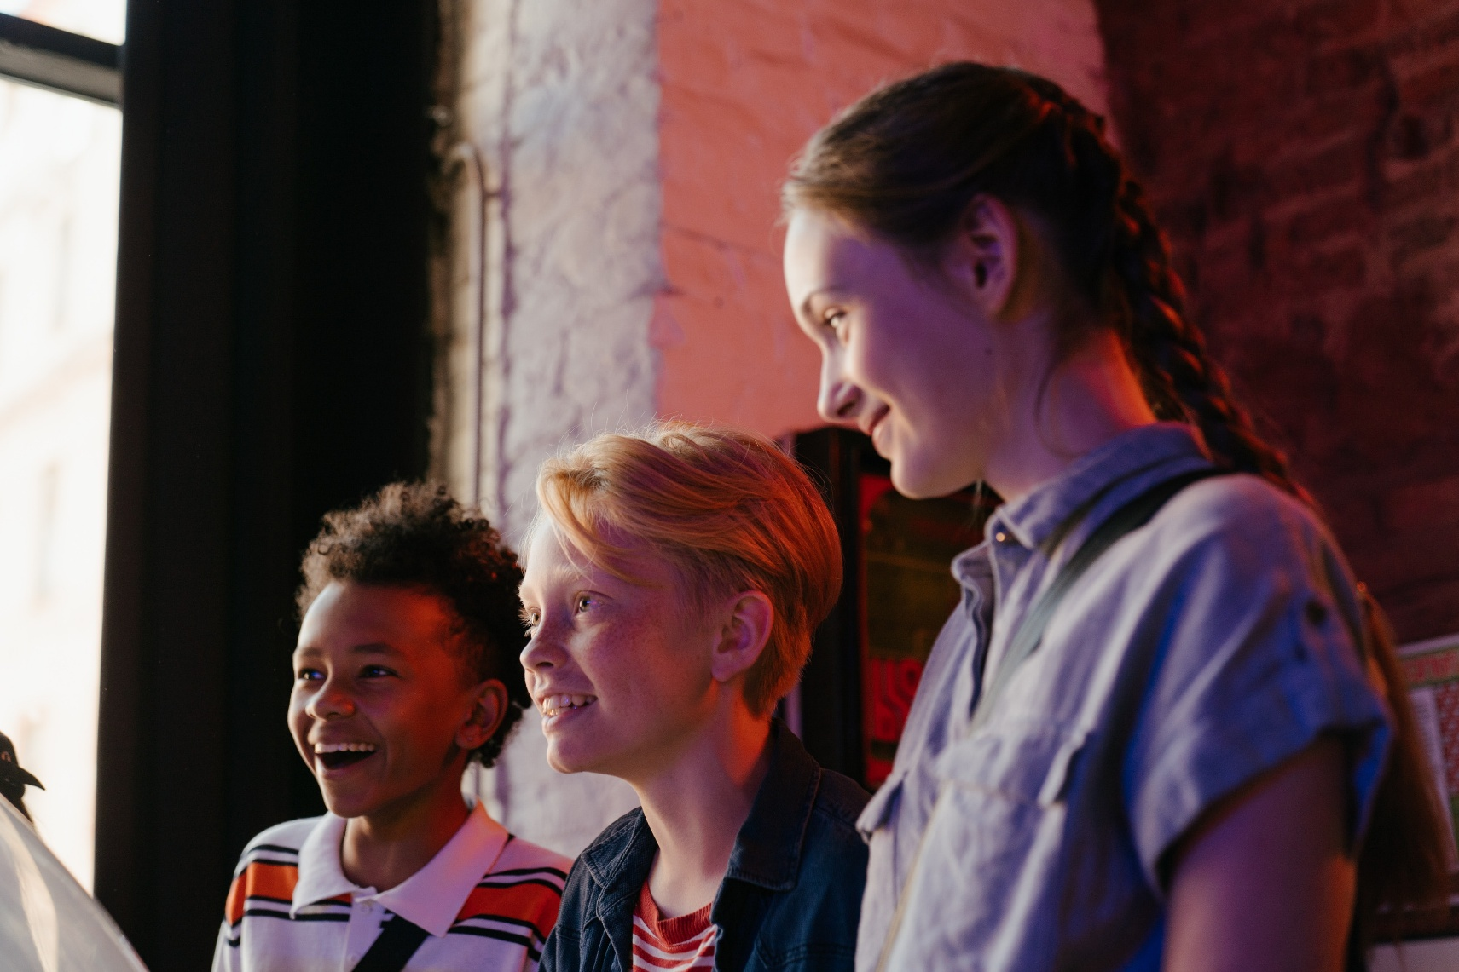
The theme of Children’s Mental Health Week is ‘This is My Place’ which is based around belonging.
Notes:
The theme of this year’s children’s mental health week is ‘This is my place’. This theme is all based around belonging.

Slide 3

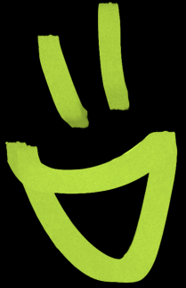
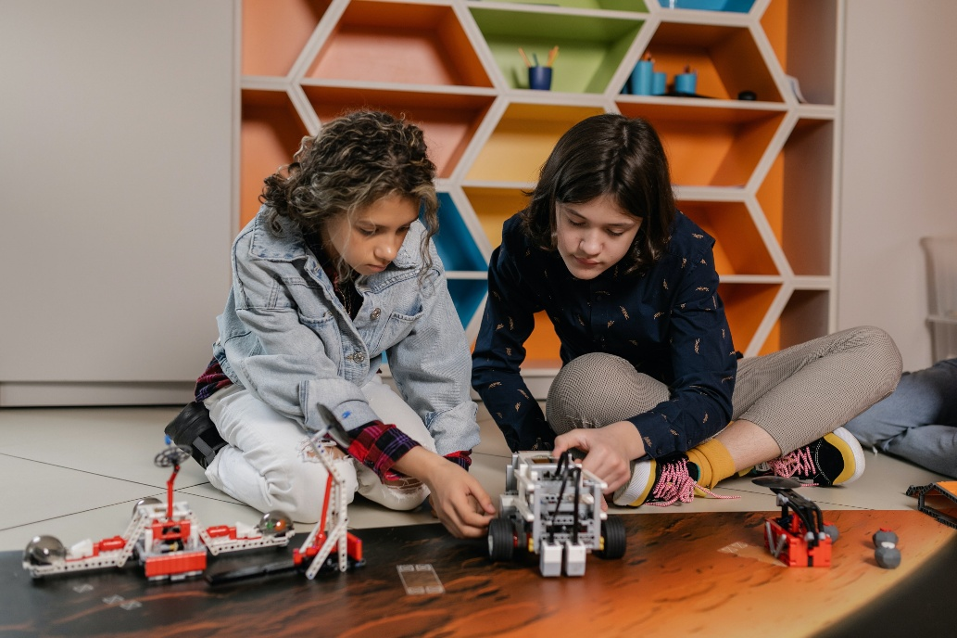
What is ‘Belonging’?
Belonging means feeling accepted, included, and valued for who you are. It’s when you feel safe to be yourself and know you’re part of something- like your friendship group, your school community or your family.
Examples of belonging:
When you have friends you can trust and spend
time with
When people listen to your opinions and respect
your ideas
When you feel proud to be part of your school or a team
Notes:
Belonging means feeling accepted, included, and valued for who you are. It’s when you feel safe to be yourself and know you’re part of something- like your friendship group, your school community, or your family.
Examples of belonging:
When you have friends you can trust and spend time with
When people listen to your opinions and respect your ideas
When you feel proud to be part of your school or a team

Slide 4

“You can’t be afraid to stand out. Your differences make you belong in your own special way."
-Simone Biles
Notes:
Simone Biles is the most decorated gymnast in history, with 7 Olympic medals and 25 World Championship medals, including multiple golds for her incredible performances.
She reminds us: ‘You can’t be afraid to stand out. Your differences make you belong in your own special way.’
Think about that- belonging isn’t about being the same as everyone else. It’s about embracing what makes you unique and using it to connect with others."

Slide 5
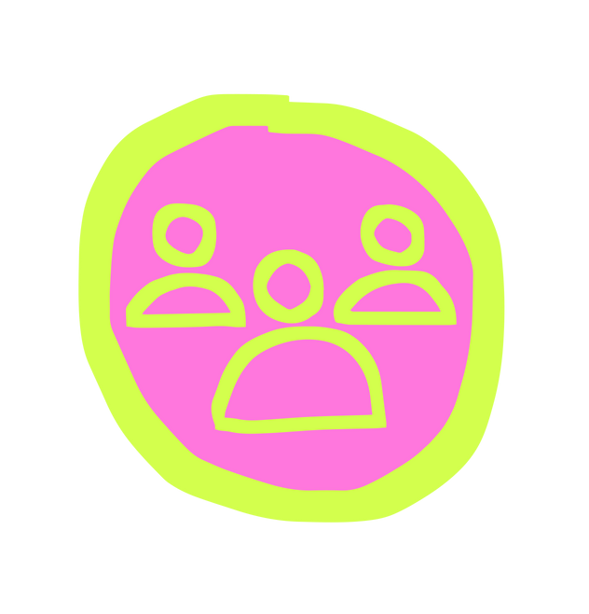


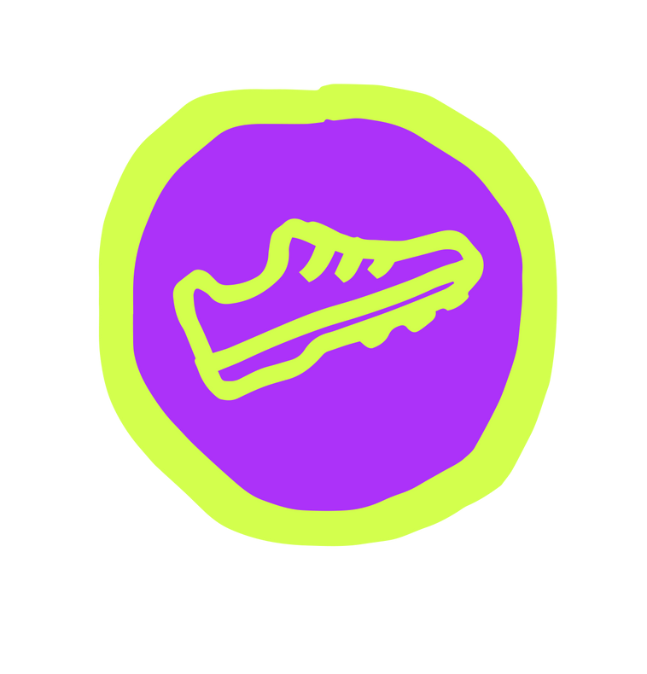
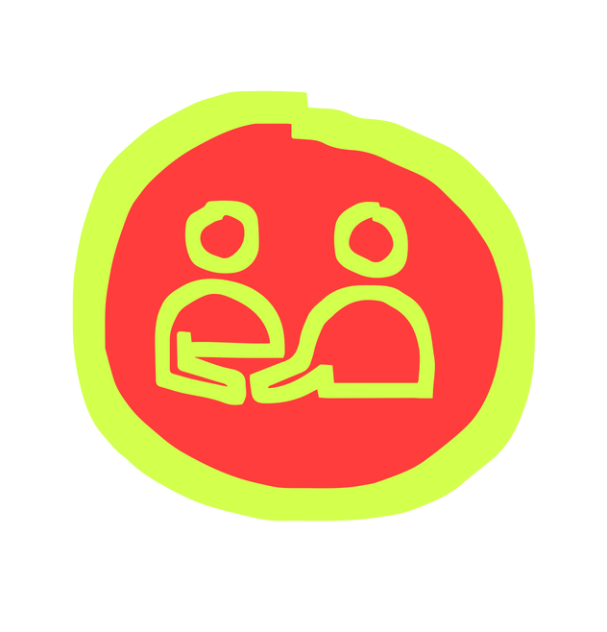

Wellbeing is
‘feeling good and functioning well’
CLANG
Notes:
Children’s mental health week is a good time to remind everyone about wellbeing. Wellbeing is feeling good and functioning well.
Knowing what makes us feel good and function well is important - and different for everyone.

Slide 6
The 5 Ways to Wellbeing
CLANG
Keep Learning
Take Notice
Connect
Be Active
Give
Notes:
The 5 ways to wellbeing can help us feel good and function well by helping us to:
Connect with others and the world around us
Keep learning new things to help us to build our self esteem and resilience. Self esteem tells us how we feel about ourselves and resilience helps us to carry on when things feel tough
Take notice of what's around us to help keep ourselves calm and comfortable, focusing on what we can see, hear and feel in our environment
Be active - we don't have to be the next Olympian to be active but we do want to move our bodies every day to help keep our mind and body working nicely together
Give - being kind and considerate is an easy way we can give back to others. When we give kindness it makes us feel good and it helps the person who we have cared for to feel good too.
An easy way to remember the 5 ways to wellbeing is CLANG.

Slide 7
CLANG
Children’s Mental Health Week is a great chance to focus on the Five Ways to Wellbeing and think about how we can link them to belonging.
Notes:
Children’s Mental Health Week is a great chance to focus on the Five Ways to Wellbeing and think about how we can link them to feeling a sense of belonging. Here are a few ideas to get you started this children's mental health week.

Slide 8
Connect
Belonging means feeling connected to others and knowing you are an important part of a community, group or team.
Turn to the person next to you and share a fact about yourself
CLANG
Notes:
Connect: Belonging means feeling connected to others and knowing you are an important part of a community, group, or team.
Let’s connect with someone now. Turn to the person next to you and share a fact about yourself. We’re going to share a fact about ourselves with you all first (pupils presenting to each share a fact about themselves)
Once you have shared, put your hand up if you would like to share your fact with the room.

Slide 9
Keep Learning
When you learn new things together, it helps you feel part of a group.
Would anyone like to share a quick skill or fact? It could be:
How to say ‘hello’ in another language
A fun life hack (like how to remember something easily)
An interesting fact about science, music, or sport
CLANG
Notes:
Keep Learning: When you learn new things together, it helps you feel part of a group.
Let’s see if we can learn something new together now.
Would anyone like to share a quick skill or fact? It could be:
How to say ‘hello’ in another language
A fun life hack (like how to remember something easily)
An interesting fact about science, music, or sport
(If confident, students presenting to share a skill or fact to start things off)

Slide 10
Be Active
Being active with others helps us to feel part of a group.
Think of an activity you enjoy- sport, dance, walking or a game. Share it with the person next to you. How could you make it more inclusive and invite others to join?
CLANG
Notes:
Be Active: Being active with others helps us to feel part of a group.
Think of an activity you enjoy- sport, dance, walking or a game. Share it with the person next to you. How could you make it more inclusive and invite others to join?
(If students presenting feel confident to, they could lead a simple activity or game they know with the assembly)

Slide 11
Take Notice
Take time to notice the things that are special to you and make you feel happy around your home and school.
Look around. What makes this space feel like yours- maybe the work on the walls, achievements displayed or something that represents your school community?
CLANG
Notes:
Take Notice: Take time to notice the things that are special to you and make you feel happy around your home and school.
Look around. What makes this space feel like yours- maybe the work on the walls, achievements displayed or something that represents your school community?
Or take a moment to look within and notice where you feel your sense of belonging within school. This could be a sports team, club you attend or within your role such as on school council or as a Wellbeing Ambassador.

Slide 12
Give
Acts of kindness help others feel they belong. We have been thinking about our own acts of
kindness for the week…
Turn to the person next to you and share your idea for something kind you can do this week.
CLANG
Notes:
Give: Acts of kindness help others feel they belong. Acts of kindness might include: inviting someone to join a group activity, smiling at others during the day or taking the time to listen to a friend.
We have been thinking about our own acts of kindness for the week… (students presenting to each share an act of kindness they will be doing this week)
Turn to the person next to you and share your idea for something kind you can do this week.
If you feel comfortable to, you can then share it with the room.

Slide 13

Choose at least one of the 5 Ways to Wellbeing activities to do this Children’s Mental Health Week; to help yourself and others feel a sense of belonging.
CLANG
Notes:
Thank you for listening and involving yourselves today. Choose at least one of the 5 Ways to Wellbeing activities to do this Children’s Mental Health Week; to help yourself and others feel a sense of belonging.
Think about how you can then include some of these activities in the future to help both your own wellbeing and the wellbeing of others.

